Slide 1

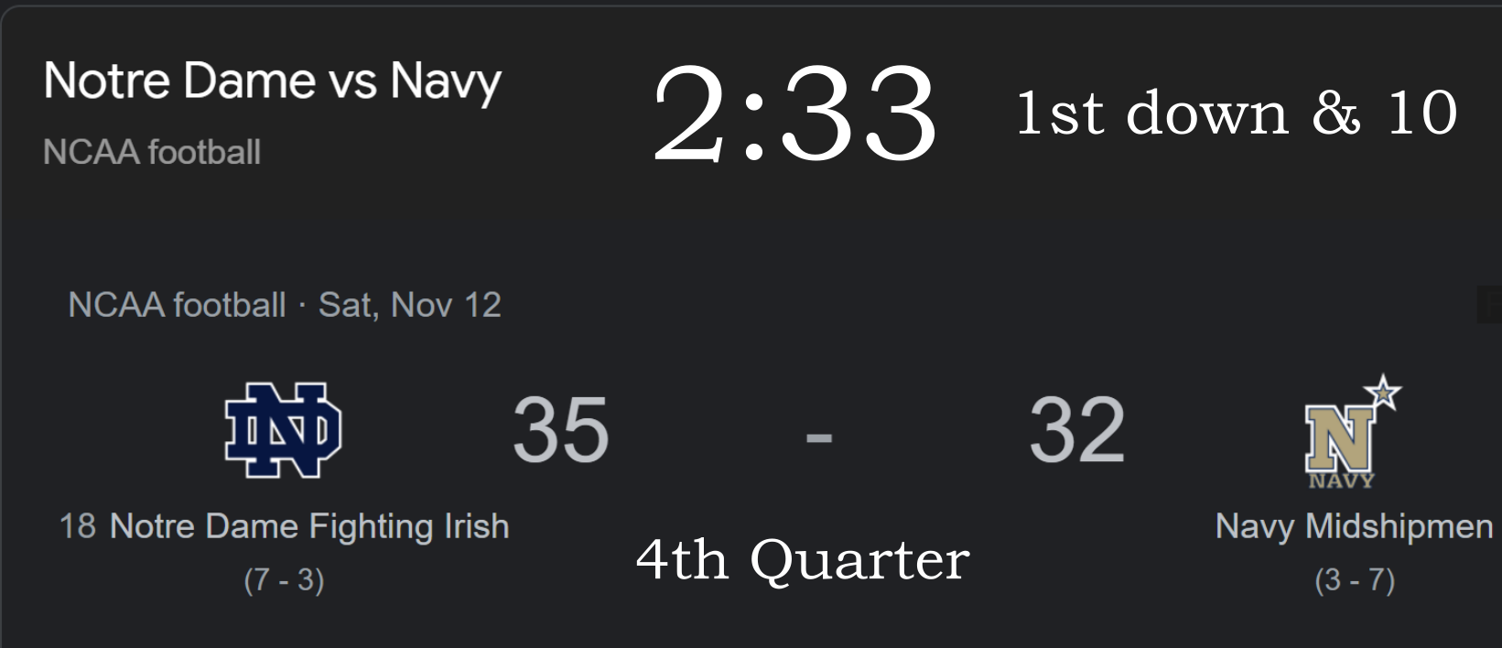
What do you see? What do you wonder?

Slide 2
The Calculation
Problem. Notre Dame has the ball with 2:33 left on the clock in the 4th quarter. It is 1st and 10. You have 40 seconds to snap the ball on each down. Does Notre Dame have a winning strategy?
Solution. Yes. They can take a knee each of the downs and win by running out the clock.
40s + 40s + 40s +40s = 2 min 40sec
Taking into account they can’t snap the ball at exactly 40 sec they still have enough time.

Slide 3
In American Football, there are four Downs
40s
40s
40s
40s
0
1st
2nd
3rd
4th

Slide 4

Kareem Abdul-Jabbar
Was the NBA all-time leading scorer with 38,387 points, and he won a record six MVP awards.

Slide 5

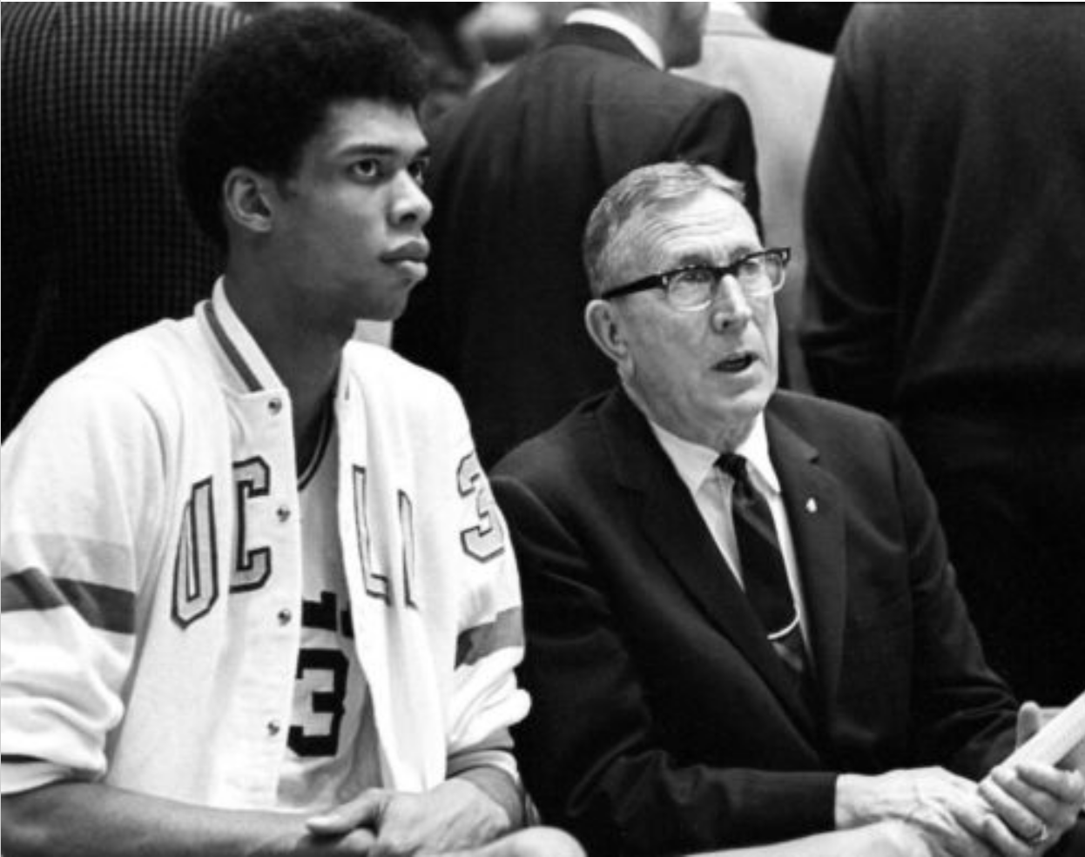
John Wooden
“Do not let what you cannot do interfere with what you can do.”
“Never mistake activity for achievement.”

Slide 6





Constant Function
*Mario is a character owned by Nintendo. This material is a learning resource that is not affiliated with or endorsed by Nintendo. Fair use.

Slide 7


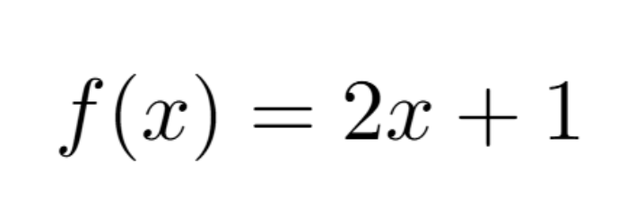

Linear Function

Slide 8



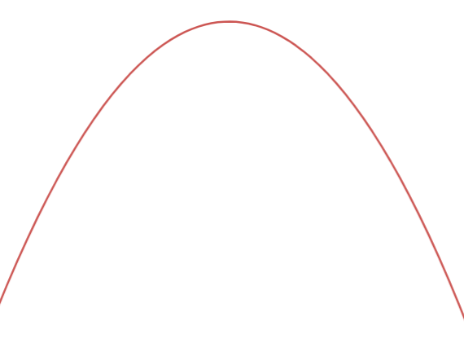





Quadratic Function

Slide 9

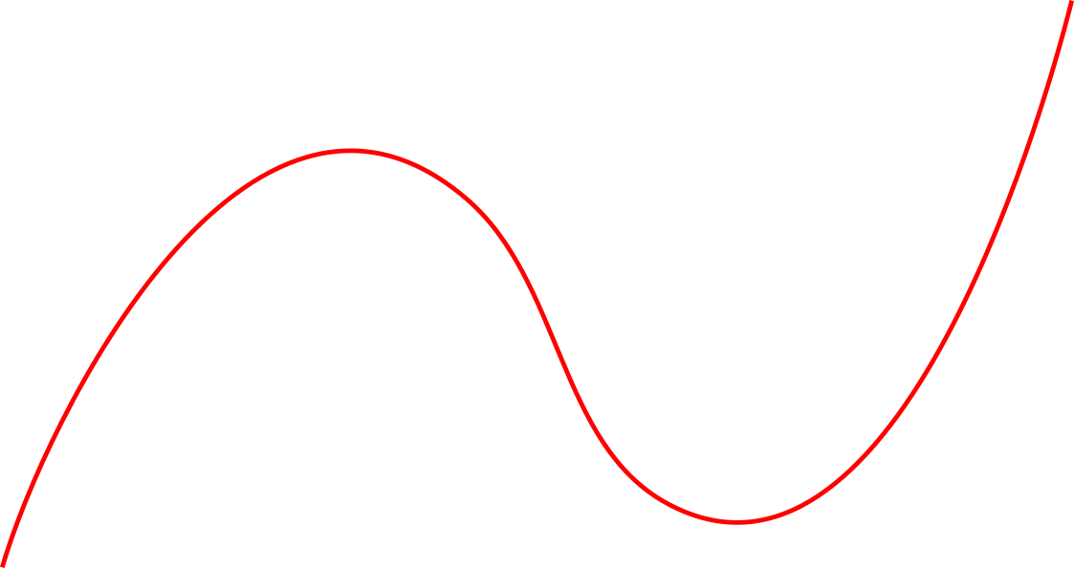

Cubic Function

Slide 10
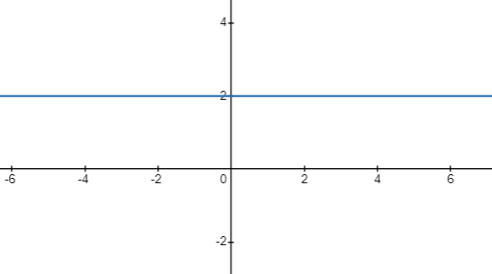

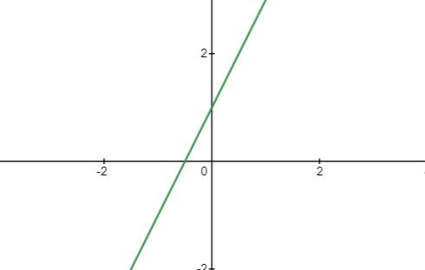

Different Functions (Single-Variable)
Constant
Linear

Slide 11
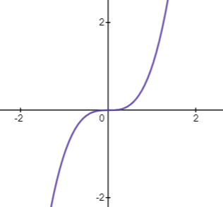

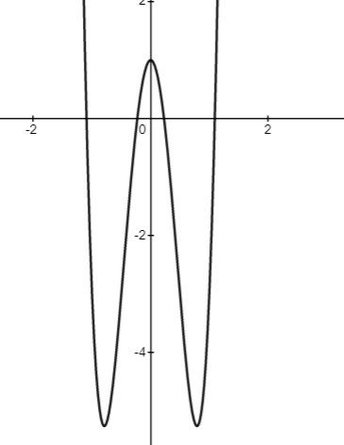

Different Functions Cont’d …
Cubic
4th degree

Slide 12

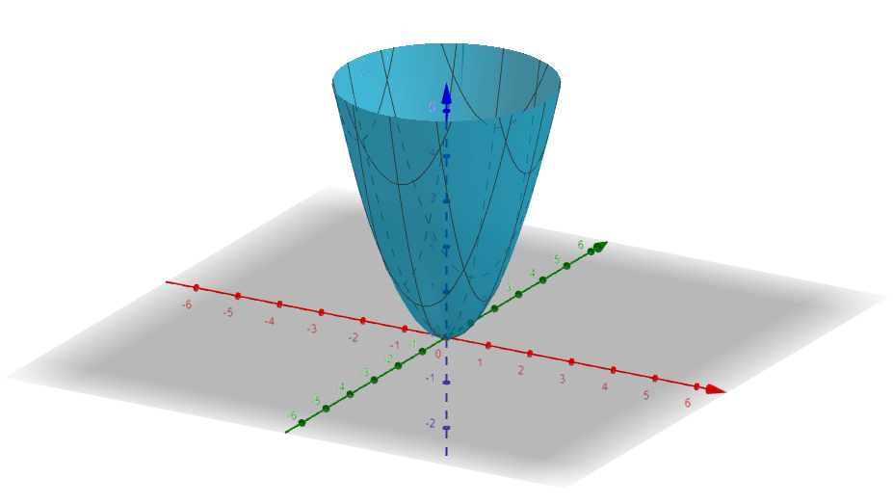

Functions of Two Variables
Translation in Geometry

Slide 13

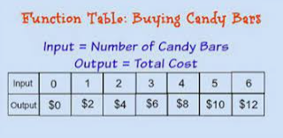

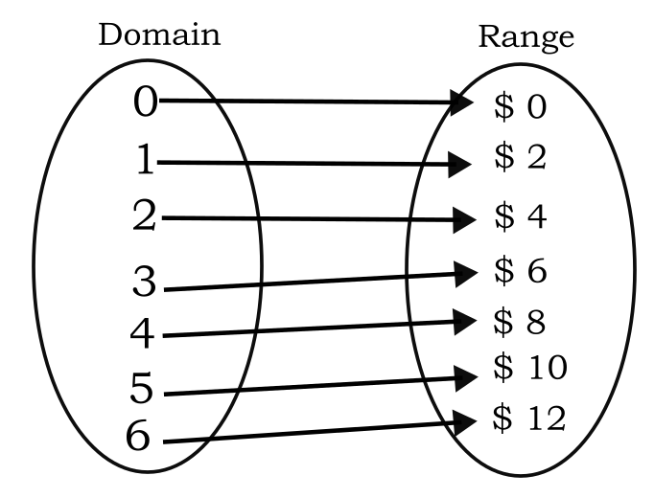
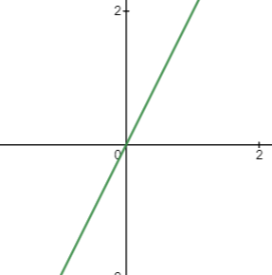
Different Representations of
Functions
Ordered Pairs
Table
Algebraic
function “rule”
Graphical
Arrows

Slide 14
Go to desmos.com. Plot all seven points and make sure the line goes through all of them.

Slide 15

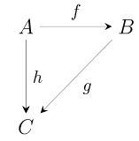



Modern Mathematics

Slide 16
Problem. Paula has been on a diet for 3 months and currently weighs 151 pounds. After 5 months of dieting, she is at 147 pounds. If her weight loss follows a linear progression, find how much weight she has lost after 8 months.
Solution. We view these as data points (t, w) on the time-weight axes. So we have two points (3,151) and (5,147). What is (8, ?).

Slide 17
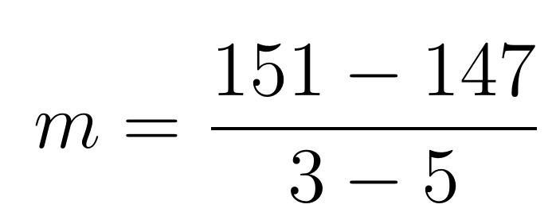
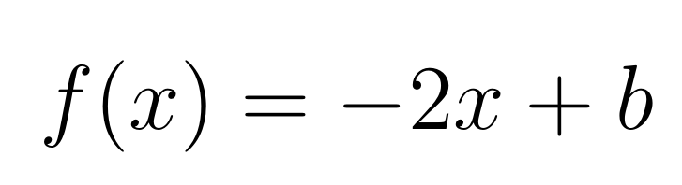
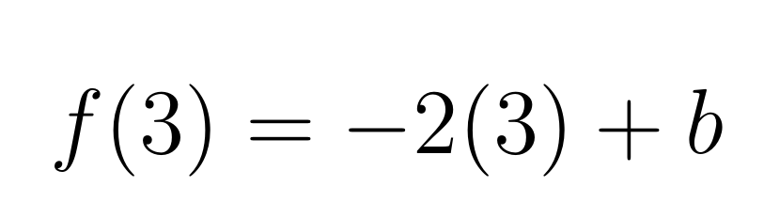
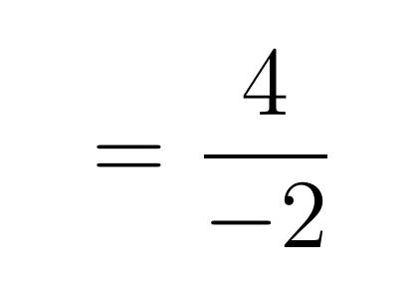
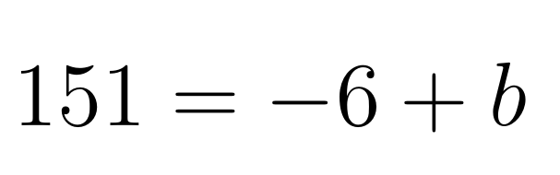
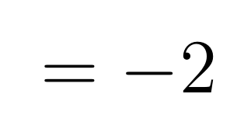
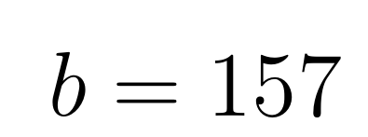
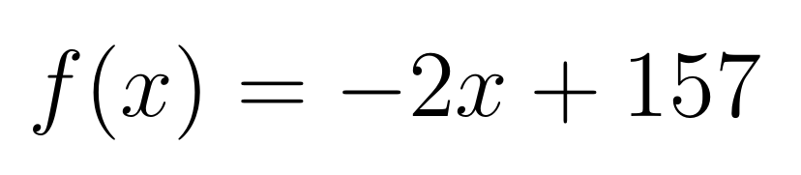
Slope
Function

Slide 18
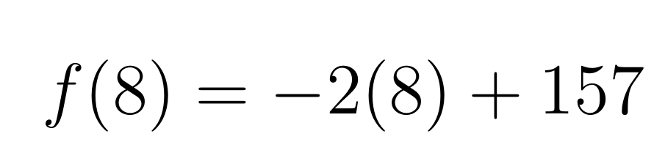
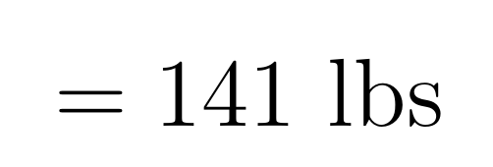

Slide 19
Problem. If f(x) = 3x + 2, find a) f(0) b) f(1) c) f(1/3)
Solution. a) f(0) = 3(0) + 2 = 2 b) f(1) = 3(1) + 2 = 3 + 2 = 5 c) f(1/3) = 3(1/3) + 2 = 1+ 2 = 3

Slide 20
If you enjoyed this presentation or found it useful for teaching, please check out my YouTube channel and my book (links clickable): Learning Isn’t Linear Learning Isn't Linear: The Essential Problem, Solution, and Project Book for Students, Teachers, and Parents

